Slide 1
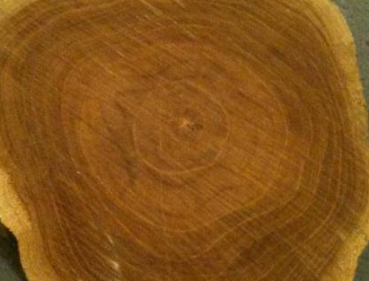
Teak
- Perception and Usage in India
Sid Bhargava, APP Timber

Slide 2
Teak has been widely used in India for more than 2,000 years. -
Source: http://www.britannica.com/EBchecked/topic/585216/teak
History of Teak Usage

Slide 3
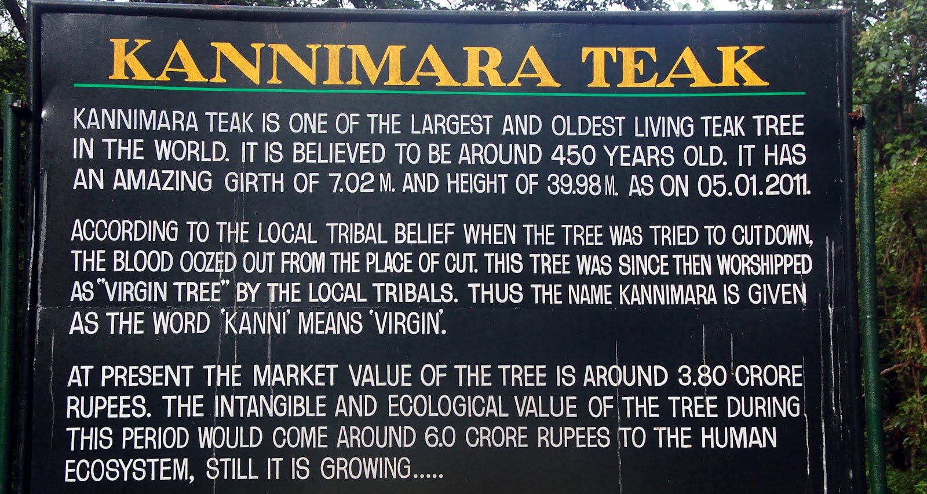

Slide 4
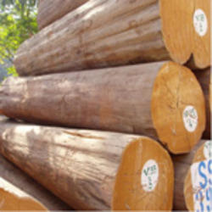
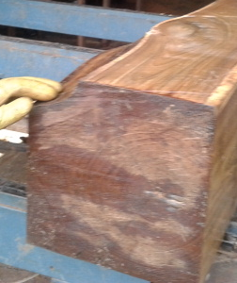
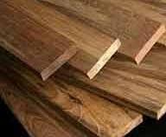
Perception
Logs Roughs Sizes
Colour
Grains
Formation of logs / square Types of sizes and lengths

Slide 5
Distribution Channel
Exporter
International Trading Agency
Manufacturer /
Small Distributor
Importer
Retail / Stockist

Slide 6
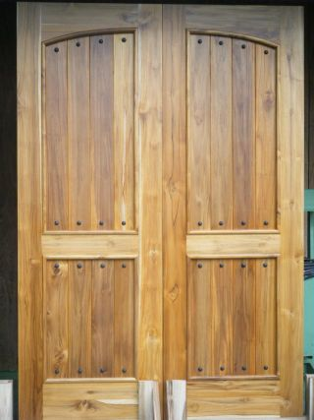
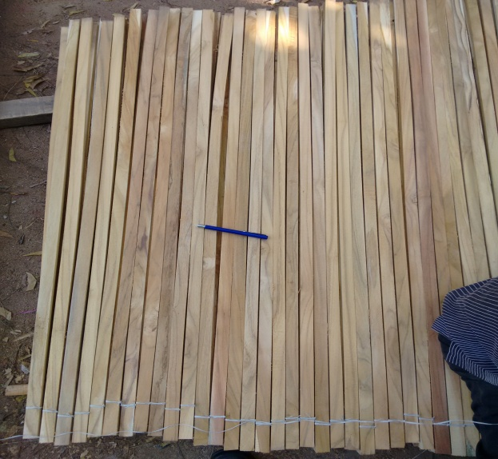
Traditional Usage
Historical Usage
Shipbuilding
Beams
Doors, Windows
Frames / (Jams)
Flooring
Panels
Blinds
Furniture
Mouldings and Margins

Slide 7
Economic Forecast for India
The Good
IMF raises India’s growth to 7.5% from 6.3% for 2015-16
India to emerge as the fastest growing economy in the world for 2015-16
More than 100 smart cities. Upgrading of existing cities, adding new infrastructure
Growing furniture industry with the emergence of online market place in furniture market like pepperfry.com, fabfurnish.com, urbanladder.com etc
Inflation falling below 6%, helping consumers with higher net disposable income
Falling crude prices helps in bringing down current account deficit

Slide 8
Economic Forecast for India
The Bad
Interest rates are still high
Infrastructure bottlenecks still remain
Banking sector is exposed to infra lending which can turn NPA (Non Performing Assets)
International demand is not very robust
A bad monsoon can cause havoc with Agriculture, putting pressure on inflation

Slide 9
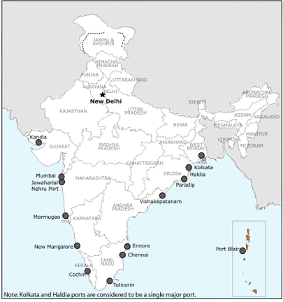
Major Ports – Market for Teak

Slide 10
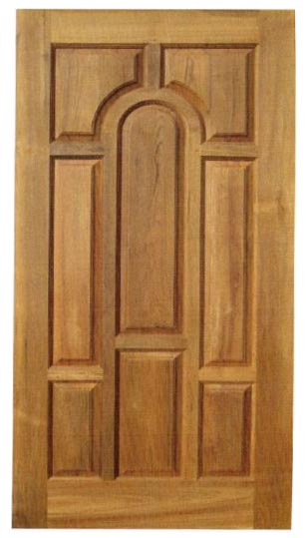
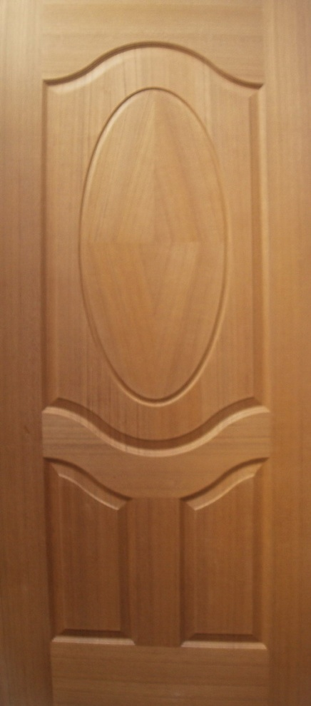
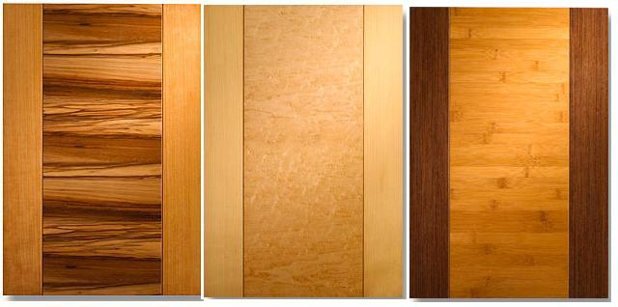
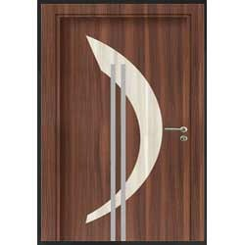
Usage of Teak in India
Doors & Frames
Traditional
Present & Future

Slide 11
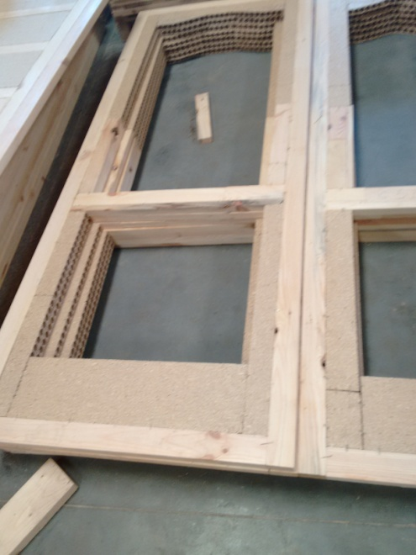
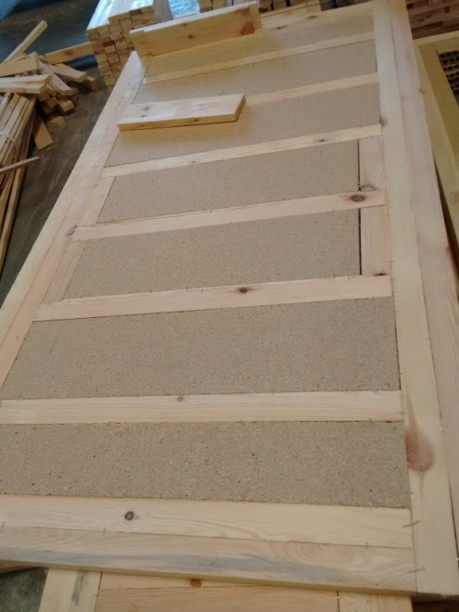
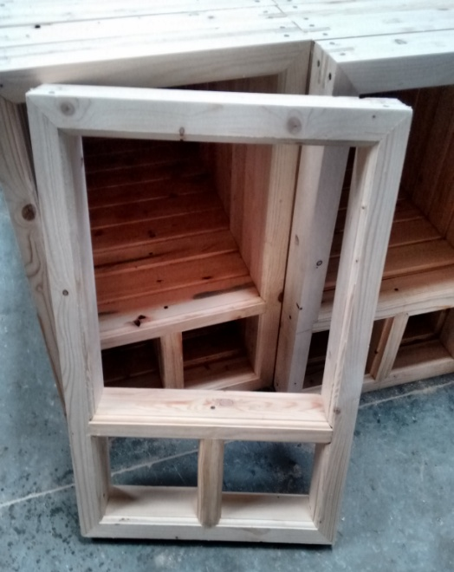
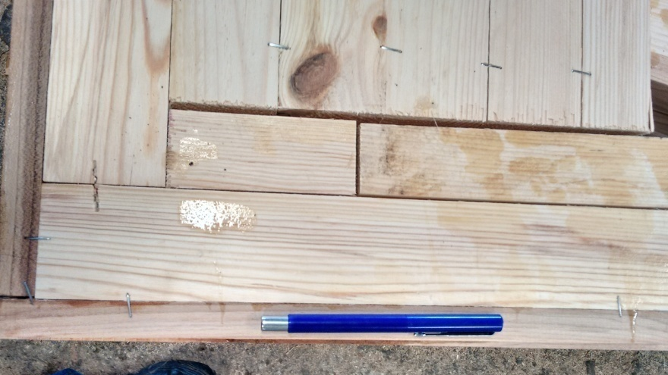
Usage of Teak in India
Doors & Frames

Slide 12
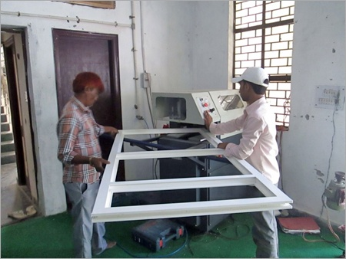
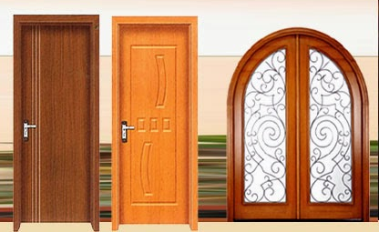
Usage of Teak in India
Doors & Frames

Slide 13
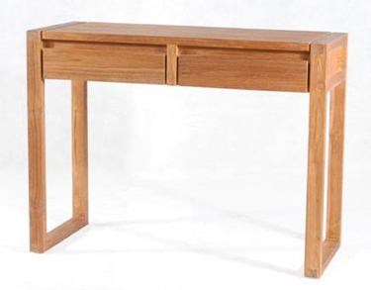
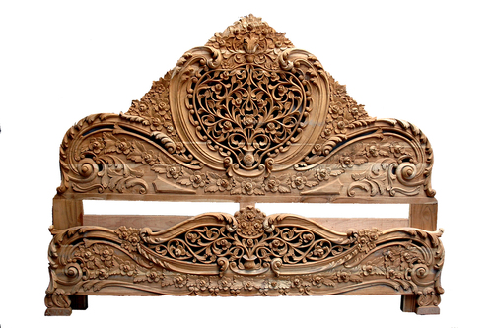
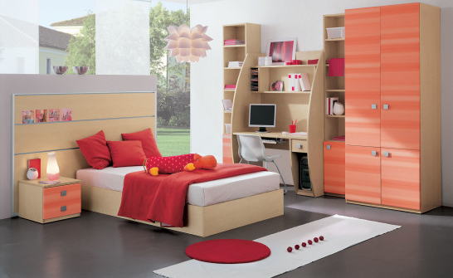
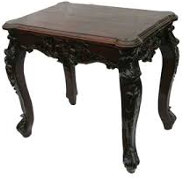
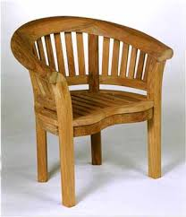
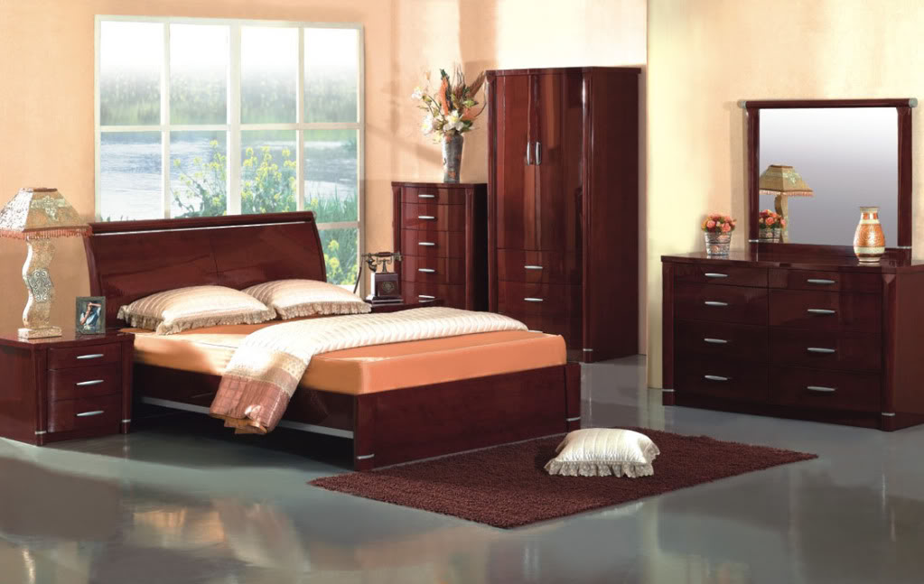
Usage of Teak in India
Furniture
Traditional
Present & Future

Slide 14
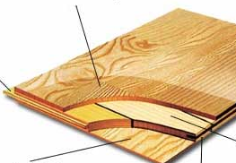
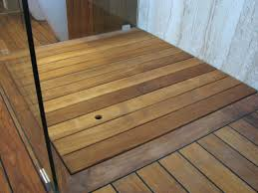
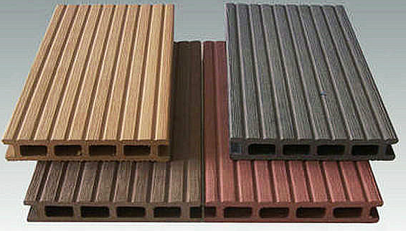
Usage of Teak in India
Flooring
Traditional
Present & Future

Slide 15
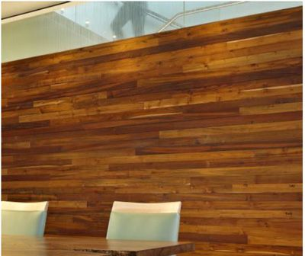
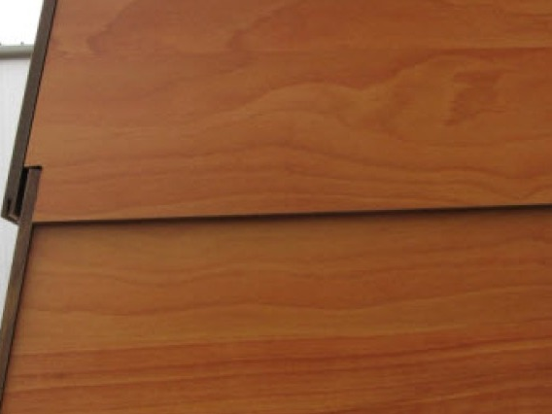
Usage of Teak in India
Cladding/ Panelling
Traditional
Present & Future

Slide 16
Thank You
Sid Bhargava
siddhartha@apptimber.com
www.apptimber.com

